Slide 1


ConnectTell
CONNECTTEL
CUSTOMER CHURN
PREDICTION
A MACHINE LEARNING APPROACH
BY
Ene Ojaide

Slide 2

ConnectTel
Company Background
ConnectTel is a leading telecommunications company that delivers a broad range of services to its diverse customer base. With a focus on innovation and customer satisfaction, ConnectTel operates in a competitive market where providing reliable, high-quality service is essential. The company continuously seeks to strengthen customer relationships and enhance user experience, aiming to stand out in the dynamic telecom industry.

Slide 3

ConnectTel
Problem Overview
The company faces a critical challenge in addressing customer churn, threatening its business sustainability and growth. The company's existing retention strategies lack precision, leading to the loss of valuable customers to competitors. It is more expensive to acquire a new customer than to keep an existing one from leaving as such ConnectTel aims to build a data-driven churn prediction system, enabling targeted retention initiatives. By leveraging advanced analytics and machine learning on customer data, ConnectTel seeks to proactively reduce churn, boost customer loyalty, and strengthen its competitive position in the telecommunications industry.

Slide 4
ConnectTel
Project Objectives
A churn prediction system will allow ConnectTel to:
Identify At-Risk Customers
Improve Customer Retention
Optimise Marketing Spend
Gain Insights into Churn Drivers
Enhance Long-Term Customer Loyalty

Slide 5
ConnectTel
Dataset Description
The dataset consist of 7043 rows and 21 key customer features:
Customer Demographics: Gender, senior citizen status, partner and dependents.
Service Details: Services such as Tech Support, Online Security, Internet Service, Multiple Lines, Device Protection, Online backup, streaming Tv, Streaming Movies etc.
Account Information: Tenure, contract type, monthly charges, and total charges.
Contract Types: Month-to-month, one-year, and two-year contracts.

Slide 6

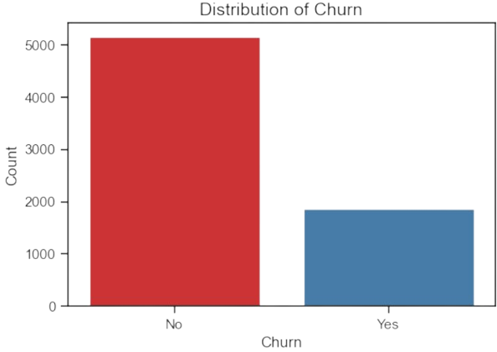
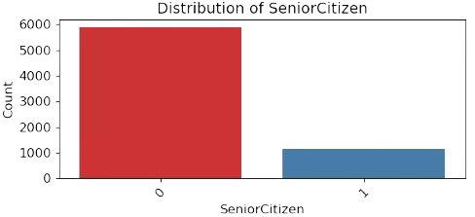
ConnectTel
Exploratory Data Analysis
A significant majority of the customers are non-senior citizens (0), while a smaller portion are senior citizens (1).
The data is highly inbalanced

Slide 7
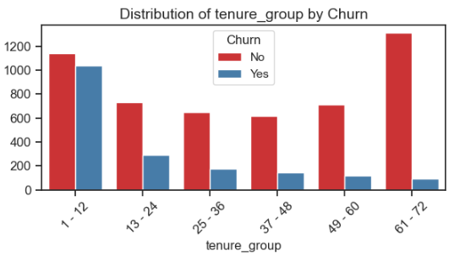
ConnectTel
Exploratory Data Analysis
The 1-12 month group has a significantly higher churn rate compared to customers with longer tenures.
As tenure increases, churn decreases, with 61-72 month customers having the lowest churn rate.
This indicates that customer retention improves significantly over time, and focusing on engaging new customers is critical.

Slide 8
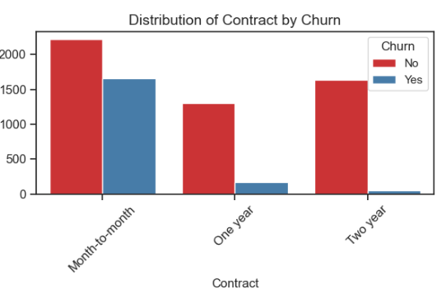
ConnectTel
Exploratory Data Analysis
Month-to-month customers have a much higher churn rate compared to those on One year or Two year contracts. Locking customers into longer-term contracts significantly reduces churn, making this one of the strongest predictors of retention.
Learn More

Slide 9

ConnectTel
Feature Engineering and Model Selection
Created tenure groups to categorize customers by their duration with ConnectTel.
01
02
Dropped Features that where irrelevant to our analysis and
those with multicollinearity such as customerid and Tenure
Tested multiple machine learning models including Logistic Regression, SGDClassifier, Decision Tree, Random Forest and XGBClassifier.
03

Slide 10
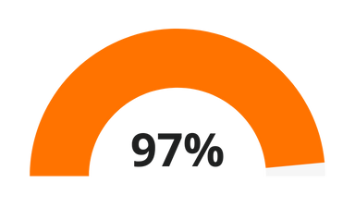
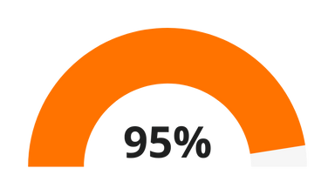

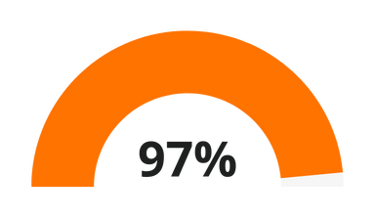
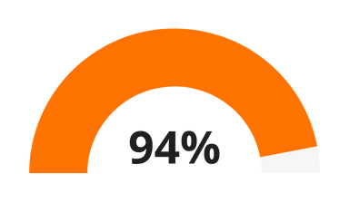
ConnectTel
Model Evaluation Using Recall
XGB Classifier
DECISION TREE
RANDOM FOREST
LOGISTIC REGRESSION
SGD CLASSIFIER
XGBClassifier with SMOTEENN is the best-performing model for ConnectTel’s churn analysis due to its superior balance of accuracy, precision, recall, and F1-score. While the recall is same , XGBClassifier’s enhanced precision and F1-score makes it more effective overall, minimising false positives while accurately identifying churners. This balance is crucial for ConnectTel, where accurately predicting at-risk customers is essential for targeted retention strategies. With fewer misclassifications across classes, XGBClassifier with SMOTEENN provides a reliable foundation for proactive, data-driven customer retention.

Slide 11
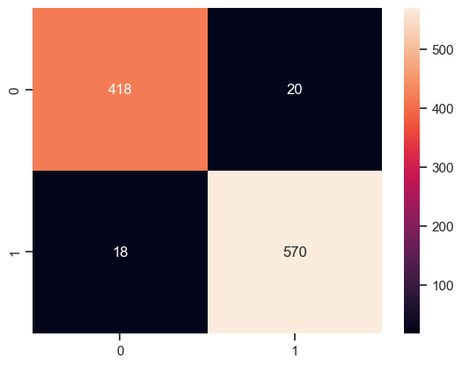
ConnectTel
Model Performance
XGBClassifier Model Performance:
Training Recall: 99%
Test Recall: 97%
Confusion Matrix and Classification Report:
The XGBClassifier achieved balanced performance across both churn and non-churn classes.
High recall and precision across classes, indicating a strong ability to predict churn while minimising false positives and False Negatives.

Slide 12
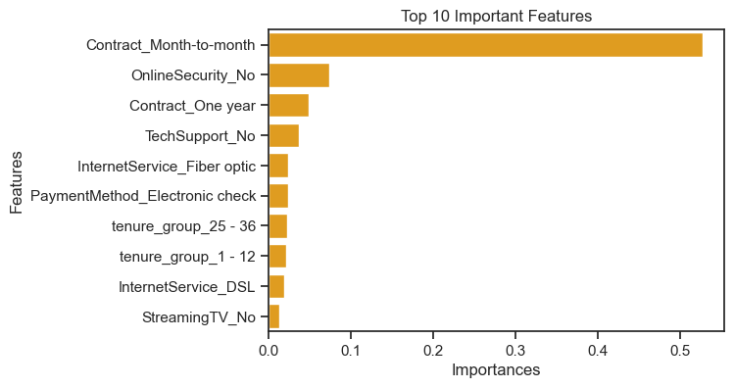
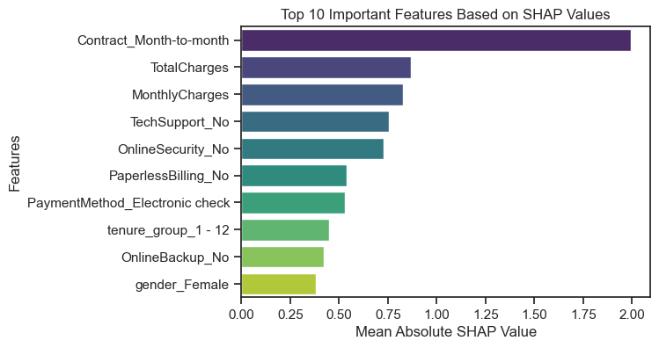
ConnectTel
Feature Importance
Model Interpretability (SHAP Analysis)
01

Slide 13
ConnectTel
Key Insights from Customer Churn Analysis
Contract Type as Primary Churn Driver
Lack of Add-on Services Linked to Churn
Higher Churn Among Electronic Check Users
Increased Churn for Fibre Optic Users
High Monthly Charges Linked to Churn
Early Tenure Churn Trends
Senior Citizens Churning at Higher Rates
Phone Service Users and Churn
These insights allow ConnectTel to understand the most critical factors contributing to churn.
01

Slide 14
ConnectTel
Recommendations
we recommend the following:
Develop Targeted Retention Strategies
Improve Service Offerings
Optimise Marketing and Retention Spend
Implement Continuous Monitoring
01

Slide 15

Connecttel
Conclusion
The churn prediction system for ConnectTel provides a powerful tool for mitigating customer attrition. By accurately identifying at-risk customers, the model enables proactive, targeted interventions that can significantly improve retention rates. Insights from the feature importance and SHAP analyses highlight critical churn drivers, offering actionable areas for improvement in customer service and contract management.
Implementing the recommendations will help ConnectTel not only retain valuable customers but also optimise marketing expenditures, increase loyalty, and strengthen its competitive position in a dynamic telecom market. This data-driven approach lays the foundation for sustained growth and a loyal customer base.

Slide 16
ConnectTel
THANK YOU

